Slide 1
Serco data science use cases POC: PRESENTATION TO BUSINESS
13 February 2023

Slide 2
Content
Use cases
Problem statement
Roadmap view
Detailed milestones
Business language
Working model
4 – 5 features
Chart
Story with each feature
Model / accuracy
Next steps forward

Slide 3
UC2: Predicting the Number of Incidents
We needed to predict the number of incidents that occurs in each single day using XGBoost model and Immigration DataBase

Slide 4
Roadmap:

Slide 5

PHASE 1
We started with getting familiar with the data, we read it from .parquet file to show samples of it and to get physical information about the dataset like:
Columns’ names and data types.
The size of the dataset.
The number of rows and columns.
The count of missing values in it.
PHASE 2
We converted the Date column into usable format for further processing.
We generated date columns from Date column, like:
Year.
Month.
Day.. Etc.
We grouped by date to get the number of incidents occurred in each single day.
We dropped off the outliers.
We Generated lagged target data that may has an impact on the predictions,
We plotted the correlation between the overall dataset.
PHASE 3
We separated the learning data from the target data.
Scaling the learning data.
Creating training samples and testing samples.
PHASE 4
We created the XGBoost model.
Hyperparameter tuning.
Getting the best estimator after Hyperparameter tuning.
Feature selection.
Evaluate the model using metrics Like:
MAE.
MSE.. etc.
Plotting the test data against the predictions.
1
4
3
2
5
PHASE 5
We produced a .xlsx file that contains the final predictions.
Exporting the Final XGBoost model.

Slide 6
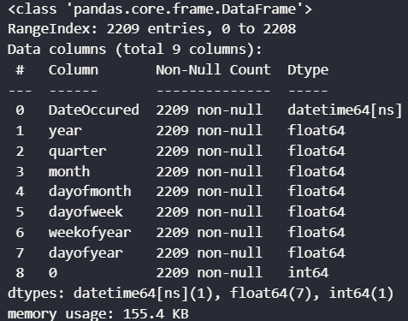
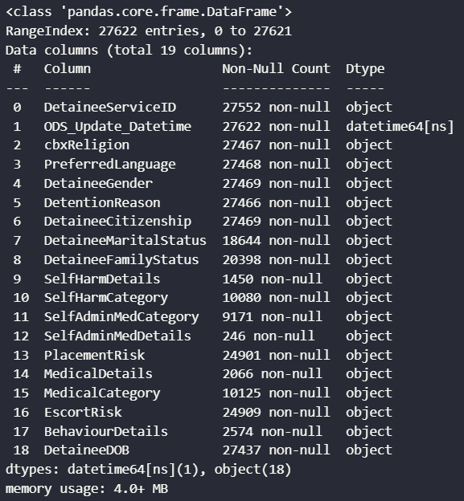
Phase 1:
In this use case we used Incident_Report, Incident_Detainees & Detainee_Profile that were in the Immigrations Database, as they were only the tables that we needed to get all the incidents data that we needed to build our model that can predict the number on incident that occurs in each day.
In phase 1 we needed to get an overview of those tables to see how we’re going to clean, group and preprocess them before the modeling process, so we started by showing an sample of each table individually, then we showed an brief information about each table, that was:
The number of rows and columns in each table.
Columns’ names and data types for each table.
The physical size of the table.
The count of missing values in it.
So, after we got all the required information about the data that we’re going to work, we knew how the rest of the phases will go.

Slide 7
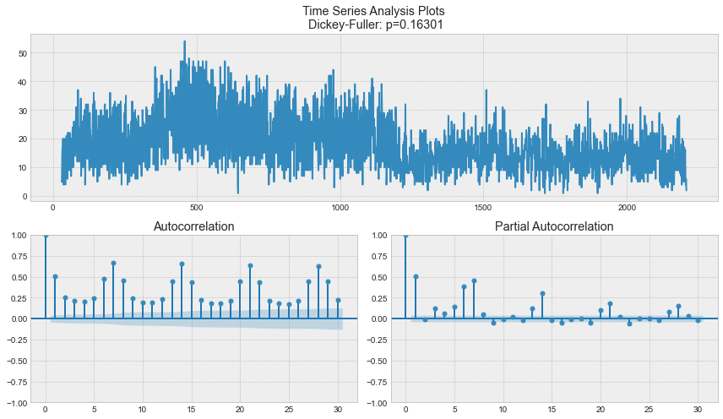
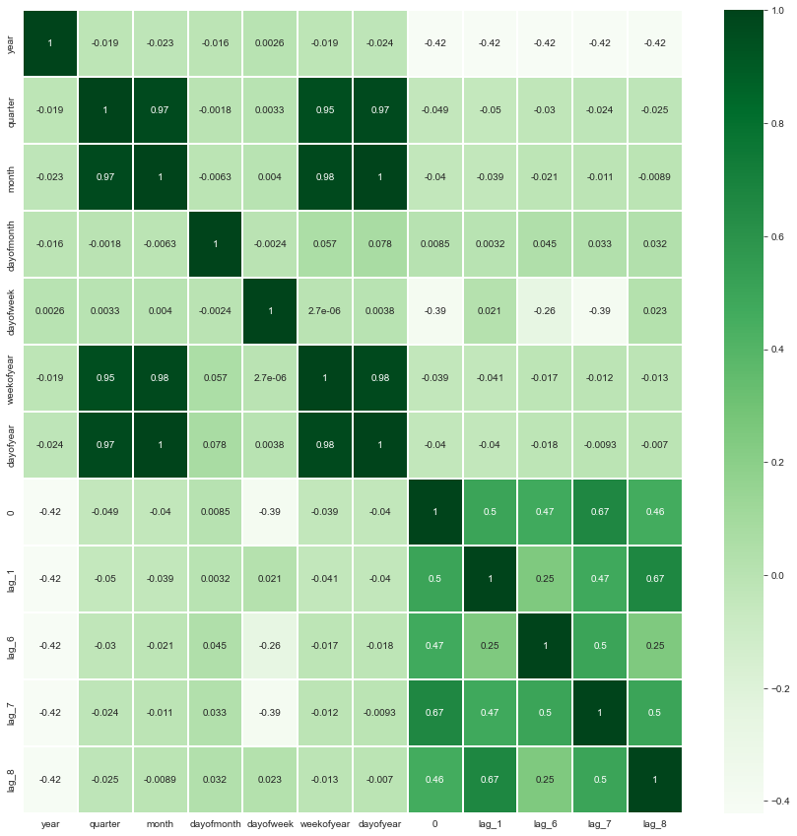
Phase 2:
In phase 2, and after we knew all the issues in our data in phase 1, we started to clean, wrangle, and group the data to meet the required standards to be fitted in the model.
So as the first step in phase 2, we converted the Date column that was formatted as a string or text data typed column into a usable format called datetime format in Python for further date processing.
Then we generated some new date columns from the converted Date column to get columns like:
Year.
Month.
Day... Etc.
After finishing the processing of the Date data, we’ve become able to group by date to get the number of incidents that occurred in every single day.
And when we got the number of incidents in every single day, we found that there were some extreme outliers that needed to be dropped before the modelling process to avoid causing any skewness in the predictions.
Since we’re working on a TimeSeries Forecasting problem, we had generate lagged target data, that is past versions of the number of incidents, that may have an impact on the predictions, think about it like yesterday’s number of incidents has a correlation with today’s number of incidents, so in order to predict the number of incidents for today, we need to know the number of incidents for yesterday, and that’s why we included past or lagged number of incidents to help us predict the present number of incidents.
And for the last step in this phase, we plotted a heatmap that shows all the correlations between all the columns that we either generated or got from the original tables that we had in the beginning, to see how much our final data is correlated, and that helped us make sense of the upcoming predictions.

Slide 8
Phase 3:
Phase 3 is our preprocessing phase, in which we separated the learning data from the target data (X & Y), so the model would need to have the input of X or the learning data to be able to predict Y or the target data that is our output.
And for the second step in phase 3, we scaled the learning data, that is transforming our learning data so that it fits within a specific scale, this is a very important step that makes it easy for our model to learn and understand the problem.
And for the last step in this phase, we create training samples and testing samples out of our X and Y data, so we can train the model on the training data and evaluate its predictions by comparing it to the testing data.

Slide 9
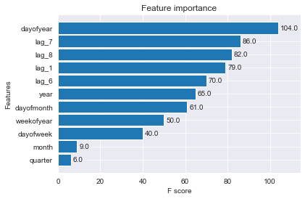
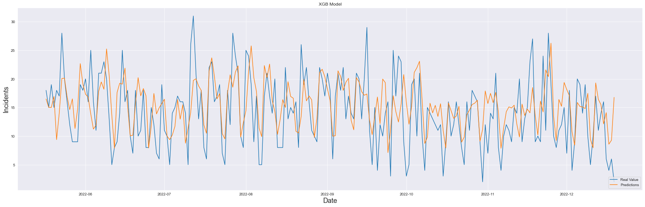
Phase 4:
Phase 4 will be our modeling phase, and we started it by creating the XGBoost model object.
Then we performed Hyperparameter tuning on it to get the best mathematical parameters for it to give the most accurate predictions as it can.
After tuning the Hyperparameters of our model, we used mathematical methods to see which features between our overall features that have the most positive impact on our model’s predictions, and we found that only 5 out of 11 features had that positive impact on our model’s predictions, 4 of them were the lagged data that we used, and that should the power of lagged data in any timeseries forecasting problem, and the other 1 feature was the dayofweek, and that also showed that the number of incidents can be affected by the day of the week, maybe because the difference in traffic between the weekdays and the weekends.
After we’re finally done with enforcing our model to get the best predictions that we can ever get out of it, we evaluated it using some mathematical metrics Like:
Mean Absolute Error (MAE).
Mean Squared Error (MSE).
Root Mean Squared Error (RMSE).
R-Squared (R²).
And lastly we plotted the test data against the final model’s predictions to see how good it has become so far.

Slide 10
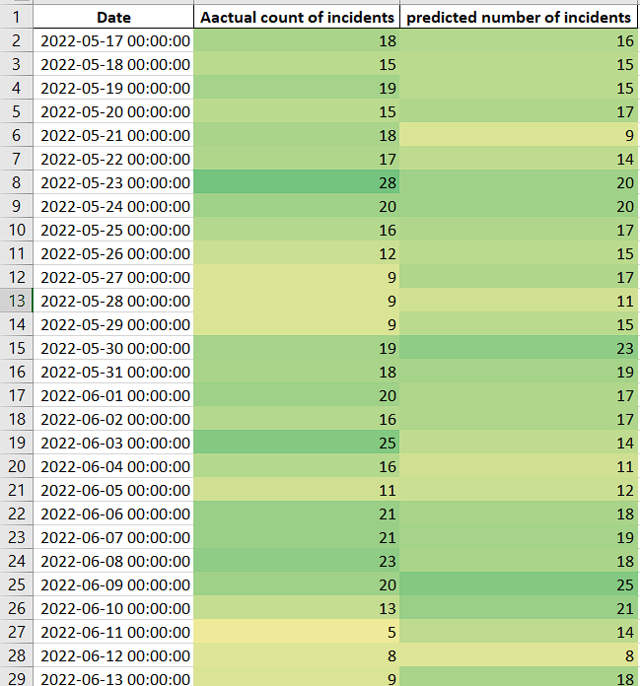
Phase 5:
And phase 5 will be our final phase that in which we produced a formatted Excel file that contains the final predictions and also the test data to be able to compare them and see how reliable our model is.
And finally we exported the Final XGBoost model as .pickle file to be able to import it again in the future and be able to deploy it.

Slide 11
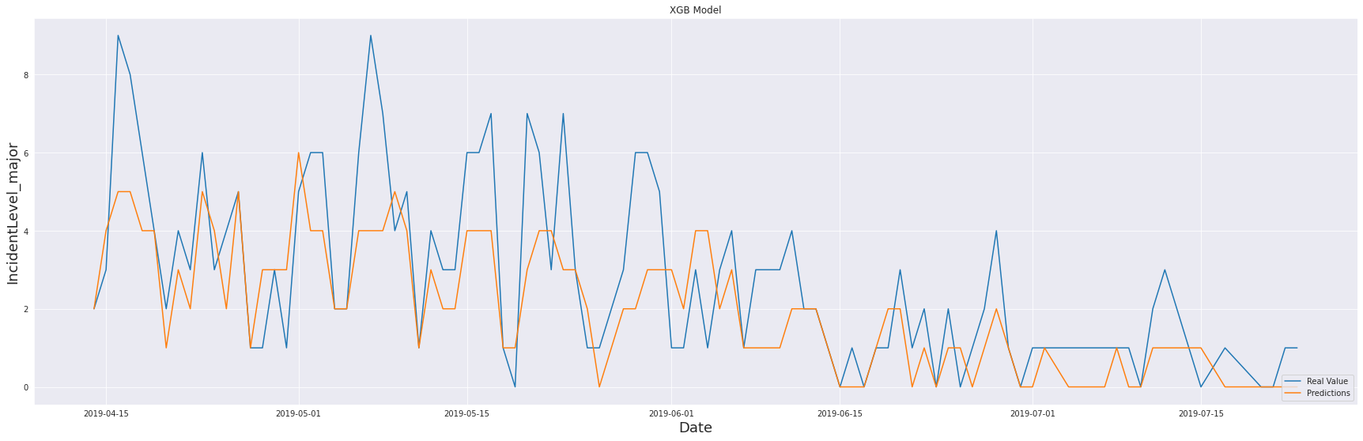
Proof of concept results summary
UC2: Predictive incident modelling within facilities to support preventative solutions
The purpose of this model was to predict the occurrence of incidents at a defined immigration detention centre. This was for Critical, Major and Minor incidents.
Data related to centre demographics, Incident Reports, Detainees, Individual Management Plans and Detainee Families were ingested to the model
The model was trained on a data set from the year 2017 to 2022 for the Villawood Immigration Detention Centre
Four sub-models were developed to explore this use case
The model displays performance metrics which demonstrate that the models are successful in predicting the occurrence of Incidents at a detention centre, and to classify those incidents at an individual detainee level
Further information is provided in the Models Details section
Model output showing actual vs predicted values

Slide 12
Operations ready
Change management
Model hardening
Retraining
Drift & output quality
Dashboard
Integration with business processes

Slide 14
Table of contents
Project Summary
Model Details
Technical Details
Appendix 1: Model UI & Dashboard Wireframes
Appendix 2: Machine Learning Techniques
Appendix 3: Data Sources

Slide 15
Project summary

Slide 16
Project summary
Purpose of this document
Capgemini Australia was engaged by Serco Australia to provide data science support in the following areas -
Identify key short-term opportunities to support both the business case and upcoming tender opportunities (Immigration Services);
Deploy a data analytics capability to deliver operational and business insights and trends based on current available data
Identify key use-cases for the deployment of AI and/or automation, with a particular focus on creating more efficient ways of working
Assist with utilising historical data sets, coupled with engineered variables for the purpose of evolving reporting and analytics into forward-thinking predictive analytics
The use case that was identified
Predictive incident modelling within facilities to support preventative solutions
An eight-week engagement commenced with a discovery phase, incorporating investigations into Use Cases, Data and Technical Environment
Two proof of concept data science deliverables in support of the use case was developed as part of the engagement
This document provides the final report, and documents the data science approach taken during the engagement. It provides summaries of the models utilised in each use case, and describes the outcomes of the modelling effort. It is the final of four deliverables provided by the engagement. It should be read in conjunction with the deliverables D1: Discovery Report and D2 & D3 PoC Model reports.
This project has proven the concept that machine learning is a responsible use of data to accurately predict Demand and Incidents

Slide 17
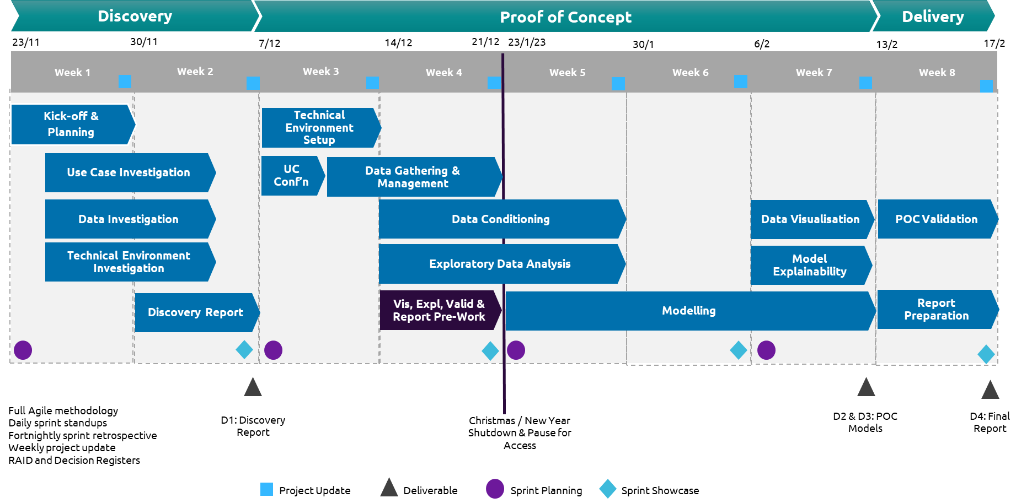
Project overview
An overview of the project stages is provided here.
A four sprint, eight-week engagement was undertaken across three phases of Discovery, Proof of Concept and Delivery
Four deliverables were proposed:
D1: Discovery Report
D2 & D3: PoC Models
D4: Final Report
Following project kick off and planning, investigations were held into the data, technical environment and use cases. Workshops with stakeholders were held to develop user stories for each use case. This culminated in the delivery of the discovery report
The technical environment was established, and data gathered, managed and conditioned using the Azure & Databricks analytics platform following consultation with technical SMEs
The project paused for 4 weeks for mid-year break and awaiting system access
Modelling using Python and XGBoost on Databricks was undertaken for the two use cases, which included the creation of data visualisations and application of model explainability frameworks.
The developed proof of concept models were code reviewed by Serco technical SMEs and signed off before final report preparation

Slide 18
Deliverables status
The status of each deliverable is presented below
# | Name | Description | Date | Format | Status
D1 | Discovery report | A summary of the discovery process | End of Sprint 2 | PowerPoint | Finalised & signed off
D2 | POC Model for UC 2 | Working demonstratable proof of concept for Use Case 2 | End of Week 7, Sprint 4 | Jupyter Notebook Python Code Summary PowerPoint presentation Model outputs | Finalised & signed off
D3 | Final report | Summary of discovery and modelling POC Recommendations for industrialisation | End of Week 8, Sprint 4 | PowerPoint | Finalised

Slide 19
Use case summary
A summary of the provided use case
 | Title | Use Case | Model | Data | Technology
UC2 | UC2: Predictive incident modelling within facilities to support preventative solutions | Identify incidents allowing for their reduction and prevention. Allow for early warning and appropriate action Ensure the ‘temperature’ checking at centres has more objectivity. Utilise data in an ethical manner; avoid bias in nationality or religion | Predict the risk of an incident occurring over a specified timeframe, for a given individual. | Incident Report Incident Detainees Centre Demographics Detainee Profile Detainee Family Individual Management Plan | Azure Data Lake Storage Azure Databricks
Please review the Discovery Report and Model Detail Reports for further information.

Slide 20
Next steps
Some potential options for next steps are presented here
Option | Description | Rough order of magnitude
Model refinement | Uplift work on each model to improve model performance and reduce errors. This might involve additional input data sets, further feature engineering, hypothesis testing and experiments, model retraining. | 1 – 2 sprints
Model generalization | Each model was developed against an example detention centre data set. Generalisation would retrain the models to make predictions against all of the centres and would store the data output so it is available for back testing for each centre | 1 sprint
Additional scenarios | Additional scenarios could be examined and tested for suitability for machine learning. This would involve gathering, conditioning and engineering data and building models to test hypotheses. | 2 - 3 sprints per scenario
Model production deployment | The existing models could be prepared for production deployment. This would involve ‘hardening’ of the model notebook Python code and integration with the Azure Data Factory and Data Lake infrastructure, together with development of supportive business facing production options such as model drift assessment, operations business engagement and production support recommendations | 1 – 2 sprints
UI and Dashboards for consumption | Dashboards hosted in PowerBI could be developed to surface model predictions and incorporate with actual operations data in a manner suitable for operations reporting. This would make use of graphs, heat maps and tabular data outputs for each model output A web based user interface as displayed in Appendix 2 would be developed which would provide a set of scenario analysis functions for the model, and which would allow them to be driven in real time. This would facilitate real-time usage of the model by Operations | 2 -3 sprints

Slide 21
Model details

Slide 22
Proof of concept results summary
UC2: Predictive incident modelling within facilities to support preventative solutions
The purpose of this model was to predict the occurrence of incidents at a defined immigration detention centre. This was for Critical, Major and Minor incidents.
Data related to centre demographics, Incident Reports, Detainees, Individual Management Plans and Detainee Families were ingested to the model
The model was trained on a data set from the year 2017 to 2022 for the Villawood Immigration Detention Centre
Four sub-models were developed to explore this use case
The model displays performance metrics which demonstrate that the models are successful in predicting the occurrence of Incidents at a detention centre, and to classify those incidents at an individual detainee level
Further information is provided in the Models Details section
Model output showing actual vs predicted values

Slide 23
Model overview
This slide provides a summary of each model generated to support the use cases
Use Case | Notebook | Title | Description
UC2 | ML-Incidents-Prediction-with-XGBoost_all_Facilities | UC2: Incident Prediction for All Facilities | This model predicts the probability of an incident occurring in the next 24 hours and its level of severity (minor, major, or critical) for all facilities
UC2 | ML-Incidents-Prediction-with-XGBoost_Villawood_Facility | UC2: Incident prediction for Villawood Facility by incident type | This model predicts the probability of an incident occurring in the next 24 hours and its level of severity (minor, major, or critical) for a detention centre by incident type
UC2 | ML-XGBoost-Predicting-Incidents-Individual_Level | UC2: Incident prediction at individual detainee level | This model predicts for each individual the estimated incident date and the level of severity of this particular incident

Slide 24
Model performance
Performance metrics for each model are provided below
Use Case | Notebook | RMSE | R² | MSE | MAE
UC2 | ML-Incidents-Prediction-with-XGBoost_all_Facilities | 0.5211 | 0.4388 | 0.2715 | 0.3494
UC2 | ML-Incidents-Prediction-with-XGBoost_Villawood_Facility | 0.5643 | 0.4570 | 0.3185 | 0.2989
UC2 | ML-XGBoost-Predicting-Incidents-Individual_Level | 0.4149 | -1.7613 | 0.1721 | 0.3653
These metrics are standard Machine Learning model performance metrics and are explained in more detail in Appendix 3 Machine Learning Techniques
Notes:
1- Mean absolute error (MAE) is a measure of errors between paired observations expressing the same phenomenon, or in other words it's measure of errors between the real values and the predictions. (The higher it goes the worst predictions are.)
2- Mean Squared Error (MSE) measures the average of the squares of the errors—that is, the average squared difference between the estimated values (predictions) and the actual value. (The higher it goes the worst predictions are.)
3- Root Mean Squared Error (RMSE) is a frequently used measure of the differences between values (sample or population values) predicted by a model or an estimator and the values observed. (The higher it goes the worst predictions are.)
4- R² (R-Squared) is a statistical measure in a regression model that determines the proportion of variance in the dependent variable that can be explained by the independent variable. (The higher it goes the better predictions are.)

Slide 25
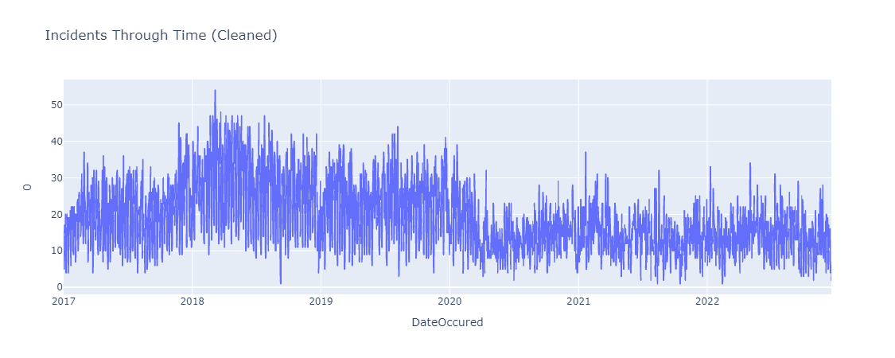
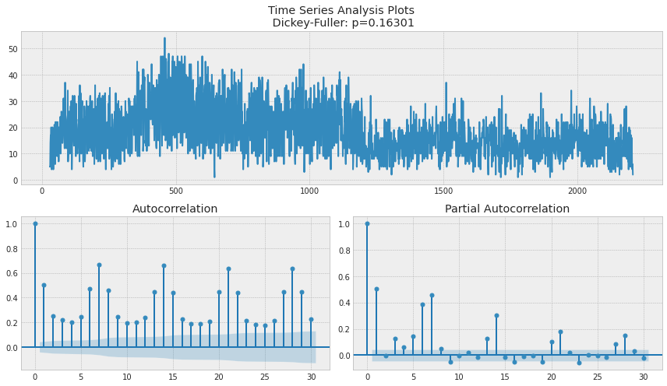
Uc2: Incident prediction at facilities
Model 1: Time series forecasting
This model used data for the total number of daily incidents per day for each facility, as plotted in the top chart to the right
In this first chart, the visible errors in the dates were fixed by plotting data from 2017 to 2022, because there are some entry errors after 2022 and before 2017.
Lagging a time series means to shift its values forward one or more-time steps, or equivalently, to shift the times in its index backward one or more steps. In either case, the effect is that the observations in the lagged series will appear to have.
The Dickey–Fuller Test tests the null hypothesis that a unit root is present in an autoregressive time series model.
From the last two charts we can find that lags 1,6,7,8 are the most effective lags to our data, and will be extracted to be features to train model ( points 1,6,7 & 8 in both graphs are the highest point and at the same time they're close to point 0, this means that they are correlated either directly or indirectly to our target)

Slide 26
Uc2: Incident prediction at facilities
Model 1: Time series forecasting
For all facilities Model 1 predicts the count of incidents occurring in the next 24 hours and its corresponding Level of severity (the features Incidents_count and IncidentLevel)
Feature Engineering was undertaken as follows - from the first chart each feature has a "Weight" that represents how much important a feature has, and this is sorted from the most important column at the top, and vice versa, so the most important features are for example: dayofyear, dayofmonth, lag_6, lag_1, lag_7, lag_8.
Visualizing the differences between Actual and Predicted data is demonstrated in the second chart, we can find that our model gives realistic predictions, as the predictions (the orange line) do not differ that greatly from the actual values (the blue line)
Variable importance
Predictions

Slide 27
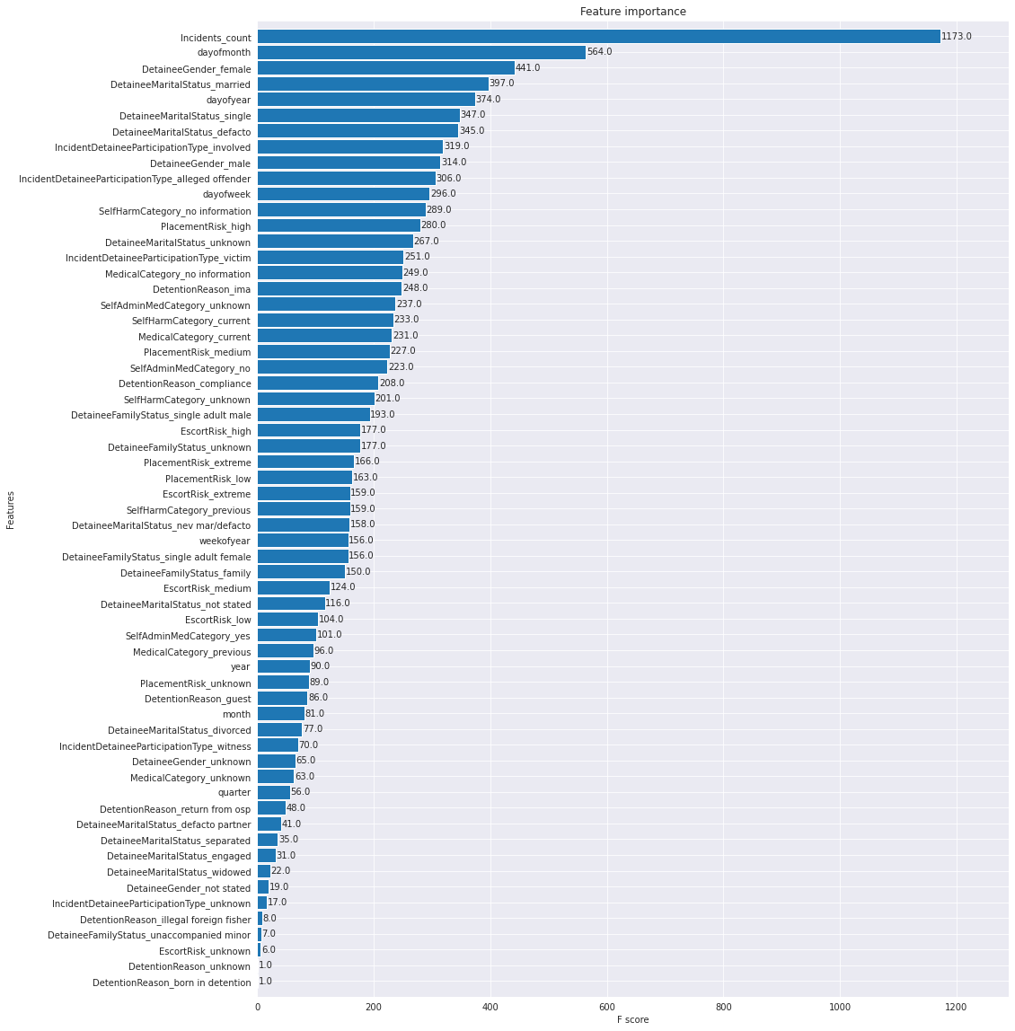
Uc2: Incident prediction at facilities
Model 2: Regression for incident level classification
For the Villawood facility, this model predicts the count of incidents occurring in the next 24 hours and its corresponding level of severity.
Input data
Incident Report
Incident Detainees
Detainee Profile
Detainee Family
Demographics
The following steps were undertaken:
Extracting usable Date features from DateOccured column
Grouping by day to get the total number of incidents occurred in each day
Plotting ACF and PACF to see if there are any data lags which can be used as features for prediction
Plot the dataset correlations to see how greatly the features are correlated to each other
Preprocessing the data to be modelled
Using GridSearchCV to tune XGBRegressor parameters and get the best estimator of it
Feature engineering and importance shown in the chart.
Using validation matrix to evaluate the accuracy of the model
Variable Importance

Slide 28
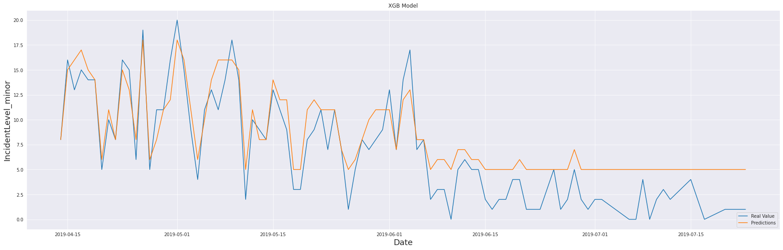
Uc2: Incident prediction at facilities
Model 2: Regression for incident level classification
The charts opposite demonstrate the visualisation of differences between Actual and Predicted Incident levels
It can be seen that both IncidentLevel_major and IncidentLevel_minor perform reasonably well in terms of predictions
Predictions are in orange and actual values are in blue
Predictions

Slide 29
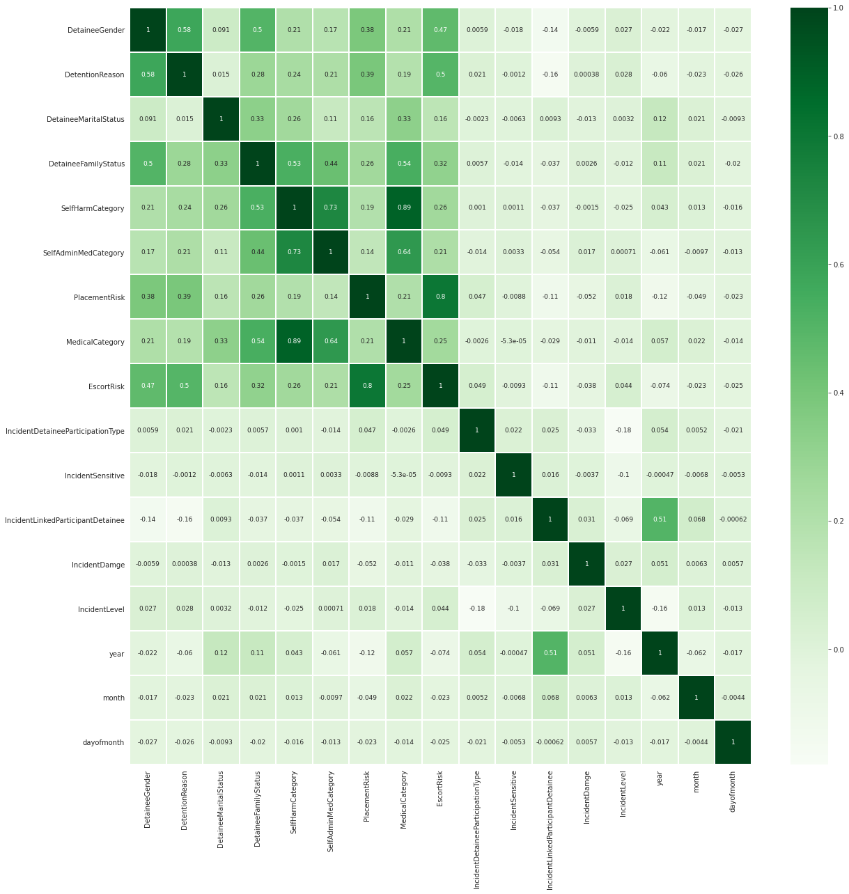
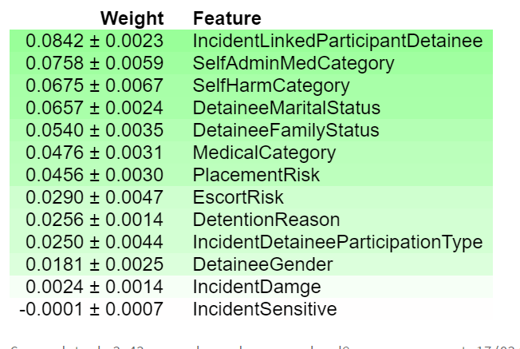
Uc2: Incident prediction at facilities
Model 3: Regression for incident level classification at individual level
Model 3 examines the ability to predict incident level classification at the individual level, namely the PID level. This utilises the same model Xgboost, and the same input data, but there has been different feature engineering and conditioning
The heatmap plot opposite shows the correlation of data which shows that several features are the most correlated features to our target.
Since there are four targets to be predicted (IncidentLevel, year, month & dayofmonth), we need to separate them all from the y_train and y_test dataframes to be in 8 series, 4 for each dataframe and 2 for each target.
To enhance the predictions, we used the ELI5 explainability framework for feature engineering and importance, and from the generated table we can find that IncidentDamage , Incident angle and Incident Sensitive columns' weights are the lowest, they mostly have a poor impact on the predictions, and we can drop them.
Input data
Incident Report
Incident Detainees
Detainee Profile
Detainee Family
Demographics
Feature Importance
Correlation

Slide 30
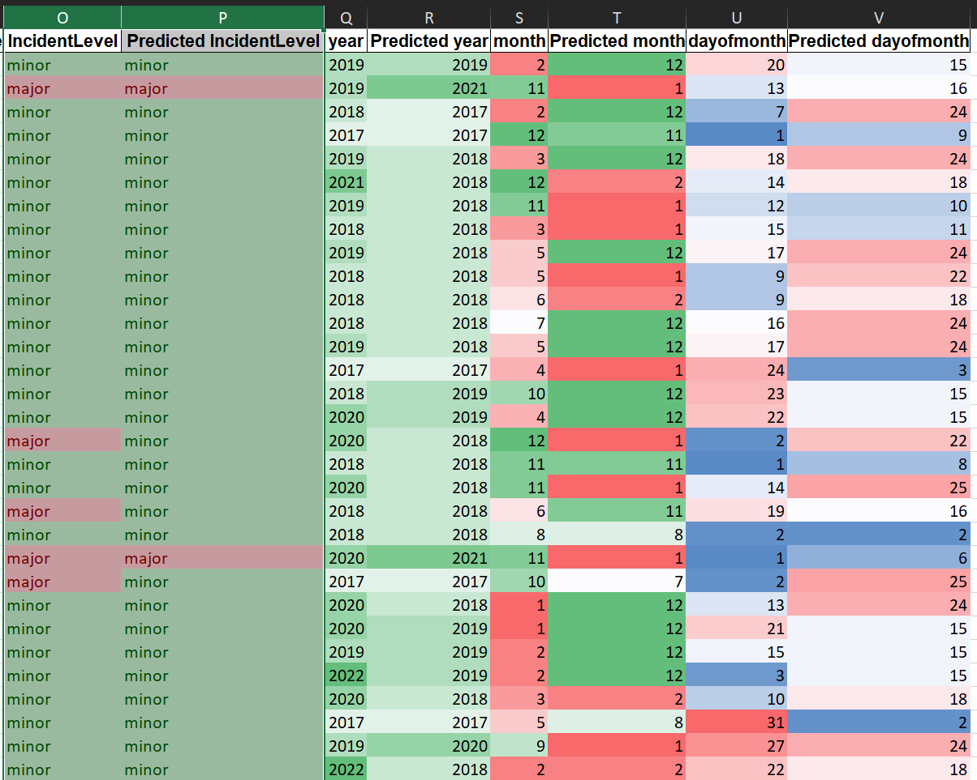
Uc2: Incident prediction at facilities
Model 3: Regression for incident level classification at individual level
For this model, the target was to predict incident level classification at the individual level
There were 4 XGBoost models that predict for each individual: - Incident level
- Year of Incident
- Month of Incident
- Day of Incident
The model predictions based on the accuracy score metrics and confusion matrix are used
The count of actual values against the predicted values for each target class is displayed in the table opposite
The model could predict the incident level and the date for each individual with an accuracy of 77.1%
Model Outputs

Slide 31
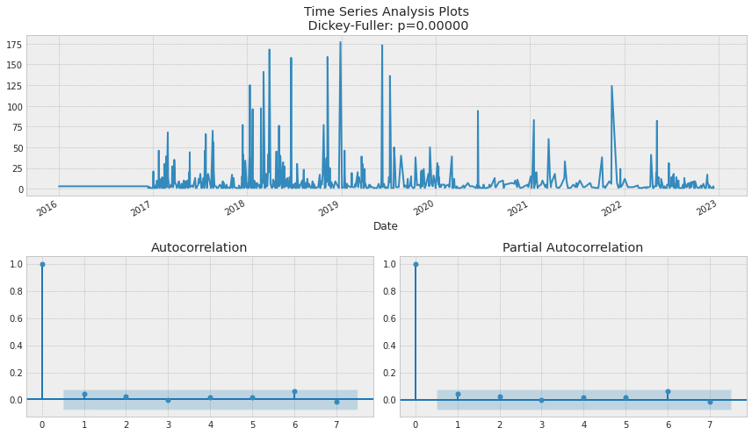
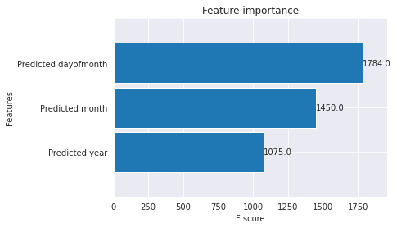
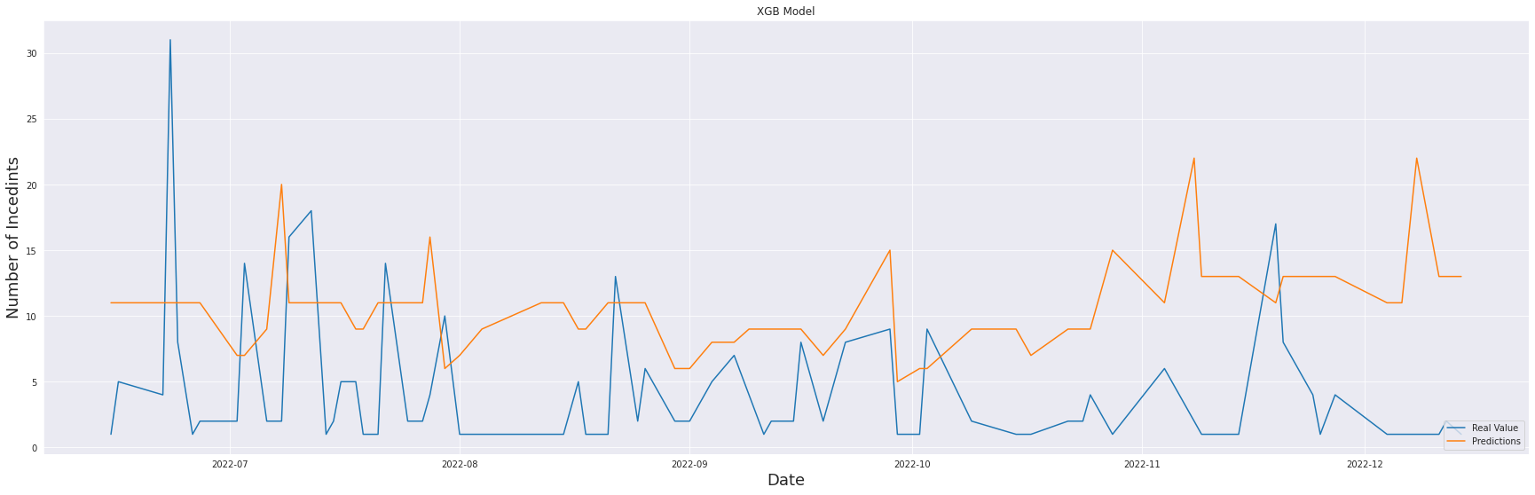
Uc2: Incident prediction at facilities
Model 4: Regression for percentage of incidents for the next day and its corresponding level of severity at individual level
In Model 4, we took the outputs of model 3 and then use that to predict the number of incidents for the next day with a probability.
From the charts we can notice that :
There are no useful lag data to be used that can help the prediction accuracy.
The data is uncorrelated
The most important features are (predicted dayofmonth, predicted months.
There are differences between actual and predicted data due to uncorrelated features
This model is of limited value and would not be included in the full suite of models
Model Outputs

